Slide 1
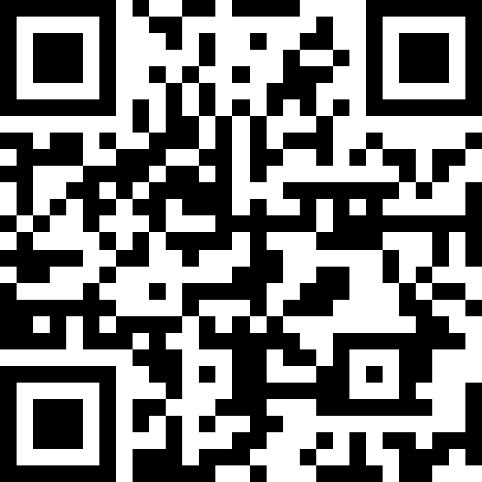
Data 6 Panel
Thursday 6/27, 9:00–10:30am
National Workshop
https://tinyurl.com/data6-interest24

Slide 2
Computational Thinking with Data and Society
Computational Thinking with Data and Society
Data 6 Origins: DUBOIS Project
I’m interested! How do I get more info?
Data 6 Panelists

Slide 3
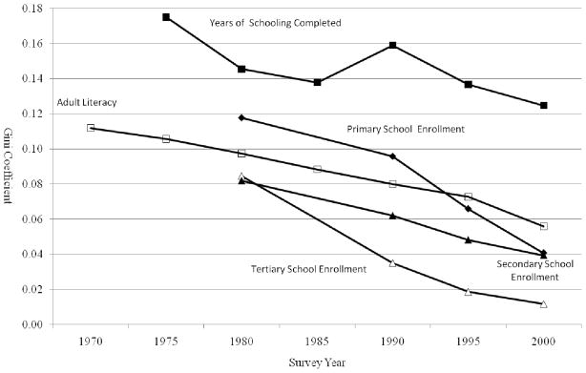
Change in Global Gender Inequality: Five Education Indicators
Data Talk:
(1) What do you notice?
(2) What do you wonder?
(3) What story does this tell, especially about the community this data may impact? What story does this NOT tell?
Dorius et al. 2010 doi
Notes:
Dorius SF, Firebaugh G. Trends in Global Gender Inequality (Forthcoming, Social Forces). Soc Forces. 2010 Jul 1;88(5):1941-1968. doi: 10.1353/sof.2010.0040. PMID: 21643494; PMCID: PMC3107548.

Slide 4

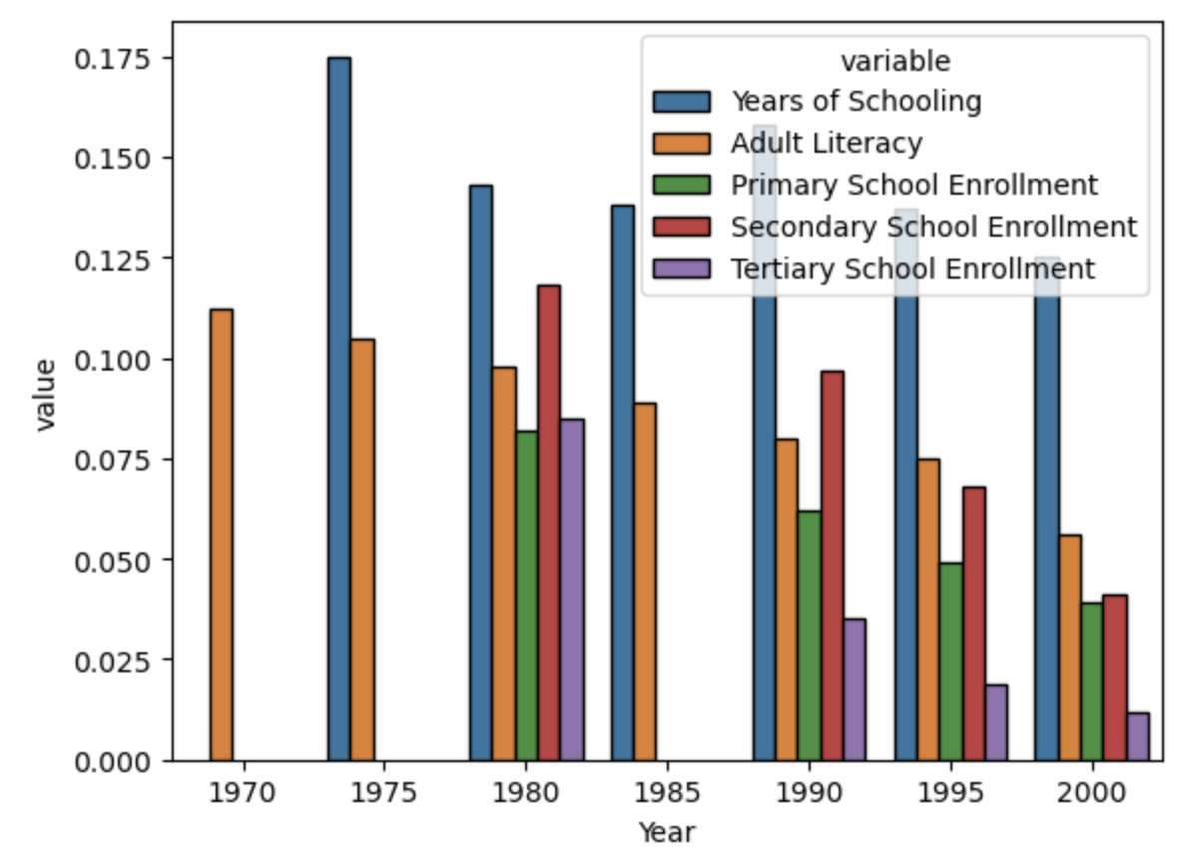
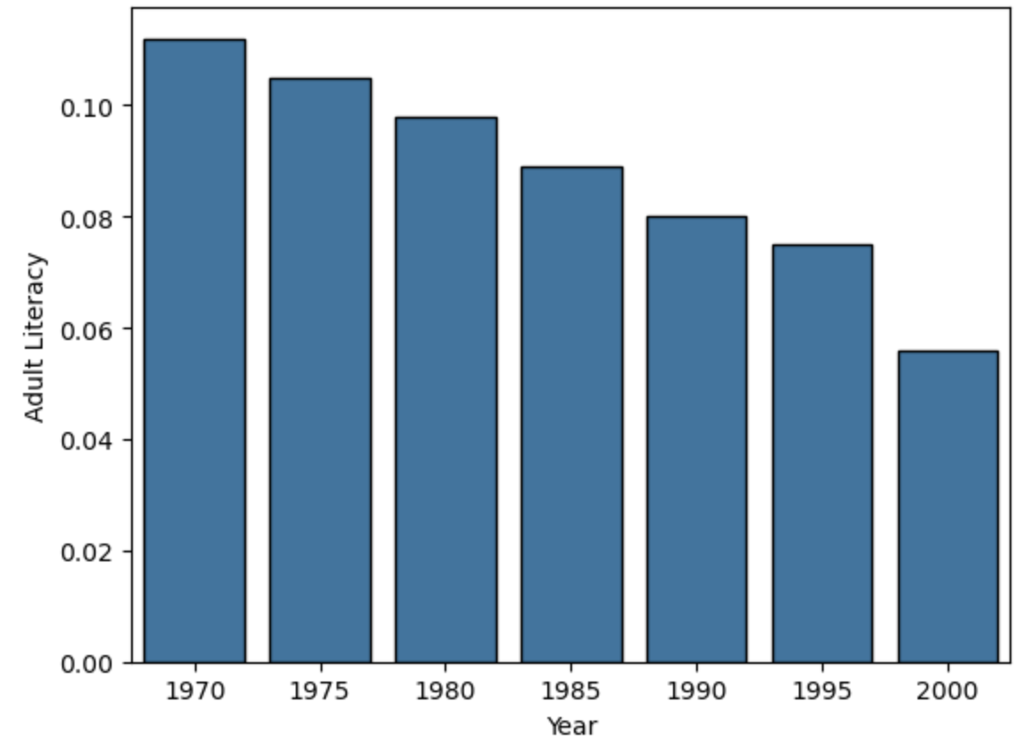
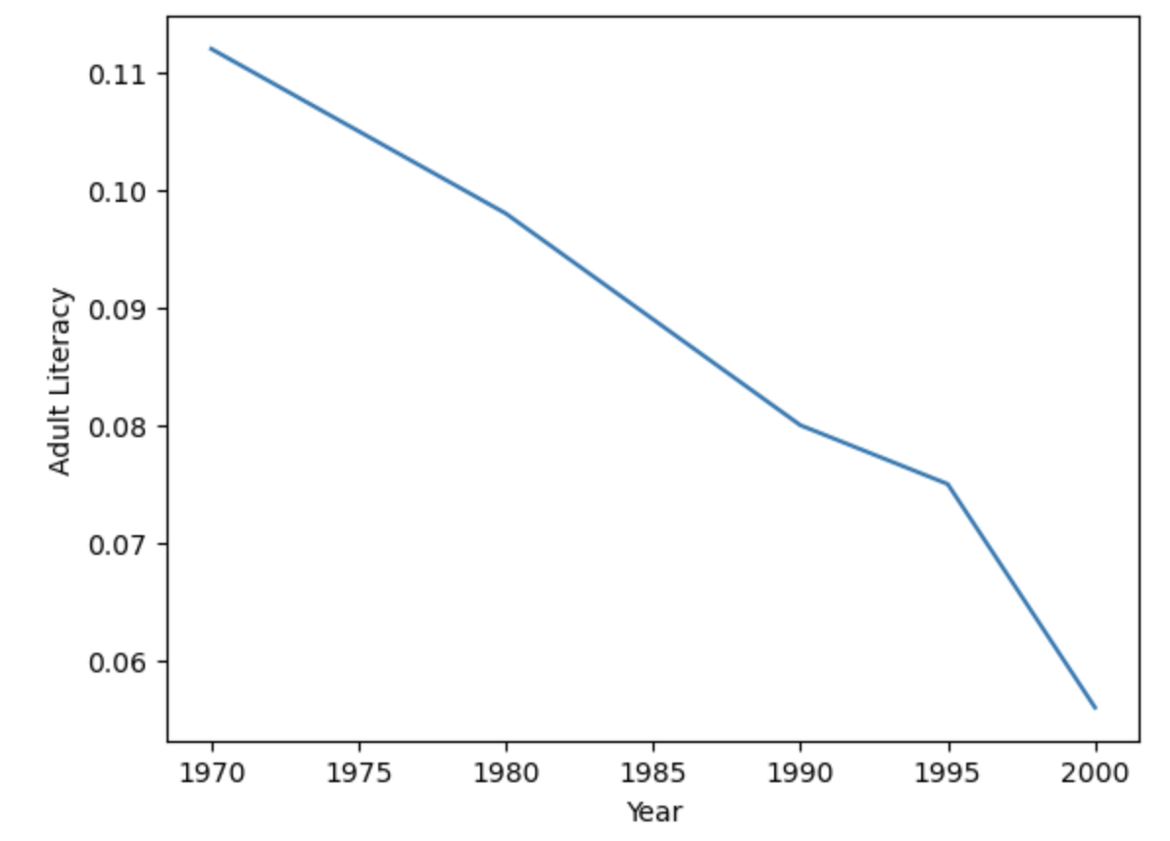
Data 6 teaches this to intro students—and more!
Change in Global Gender Inequality: Five Education Indicators
How many variables are shown in this graph?
How do you reproduce this graph in Python?
What is this statistical indicator?
Why may other visualizations not be sufficient?
Dorius et al. 2010 doi
Notes:
Dorius SF, Firebaugh G. Trends in Global Gender Inequality (Forthcoming, Social Forces). Soc Forces. 2010 Jul 1;88(5):1941-1968. doi: 10.1353/sof.2010.0040. PMID: 21643494; PMCID: PMC3107548.

Slide 5
Computational Thinking with Data and Society
Data 6 facilitates multiple entryways into data science:
Students with no prior programming experience, before Data 8
Social science students, as a terminal programming course
Students interested in introductory, interdisciplinary study

Slide 6
Computational Thinking with Data and Society
Data 6 facilitates multiple entryways into data science:
Students with no prior programming experience, before Data 8
Social science students, as a terminal programming course
Students interested in introductory, interdisciplinary study
16-week semester curriculum:
Introduction to Data Fundamentals
Visualization and Tables
Algorithms and Functions
Privacy and Text Data
A module consists of 3-4 weeks of course materials built by an interinstitutional, interdisciplinary faculty and instructor team:
Lectures
Discussions
Labs
Homeworks
Readings

Slide 7
Data 6 Origins: DUBOIS Project
Computational Thinking with Data and Society
Data 6 Origins: DUBOIS Project
I’m interested! How do I get more info?
Data 6 Panelists

Slide 8

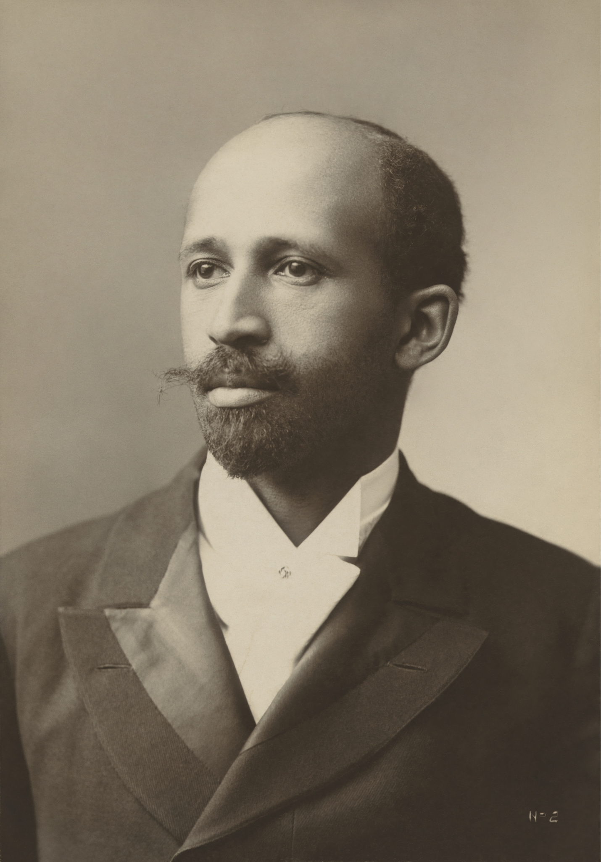


How do we broaden early participation in Data Science?
Data science for Undergraduates to Broaden Opportunities for advancing an Inclusive Society
Close up on Atlanta University's "City and Rural Population. 1890" data visualization link

Slide 9
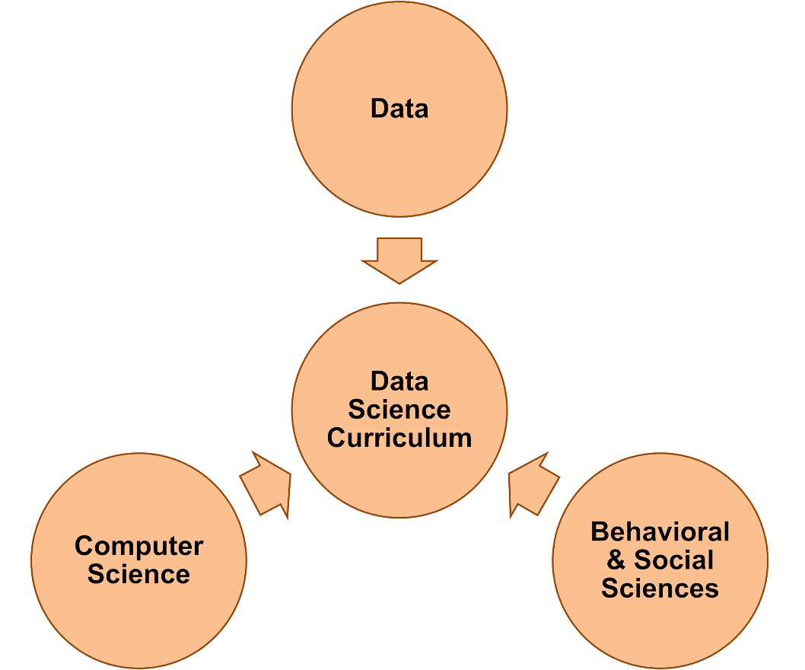




How do we broaden early participation in Data Science?
Goal 1. Create open-source, modular introductory DS curriculum at the intersection of computing, statistics, and the social and behavioral sciences.
Goal 2. Build faculty & institutional experience with culturally relevant DS curriculum to attract students with diverse backgrounds & interests.

Slide 10
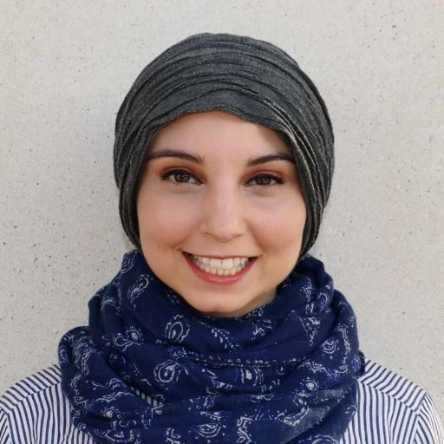
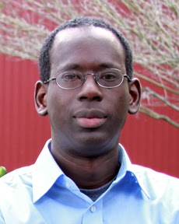
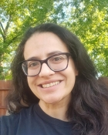
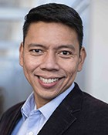
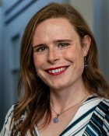
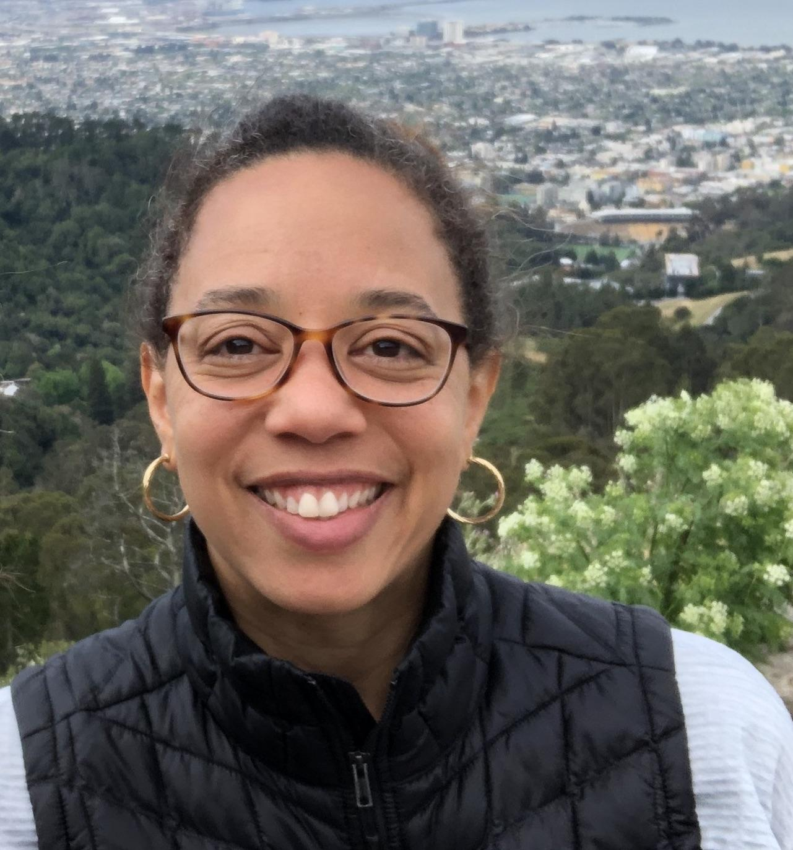
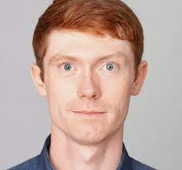
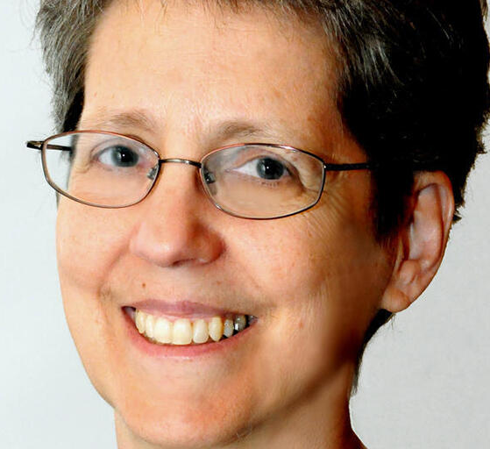
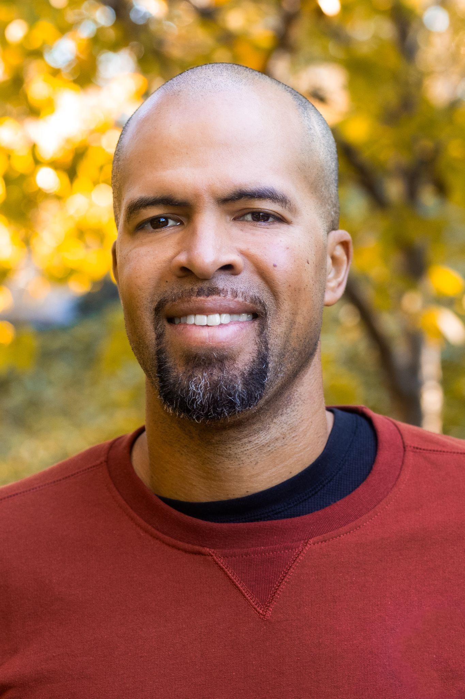
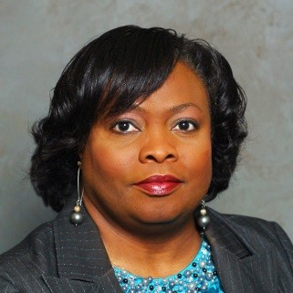
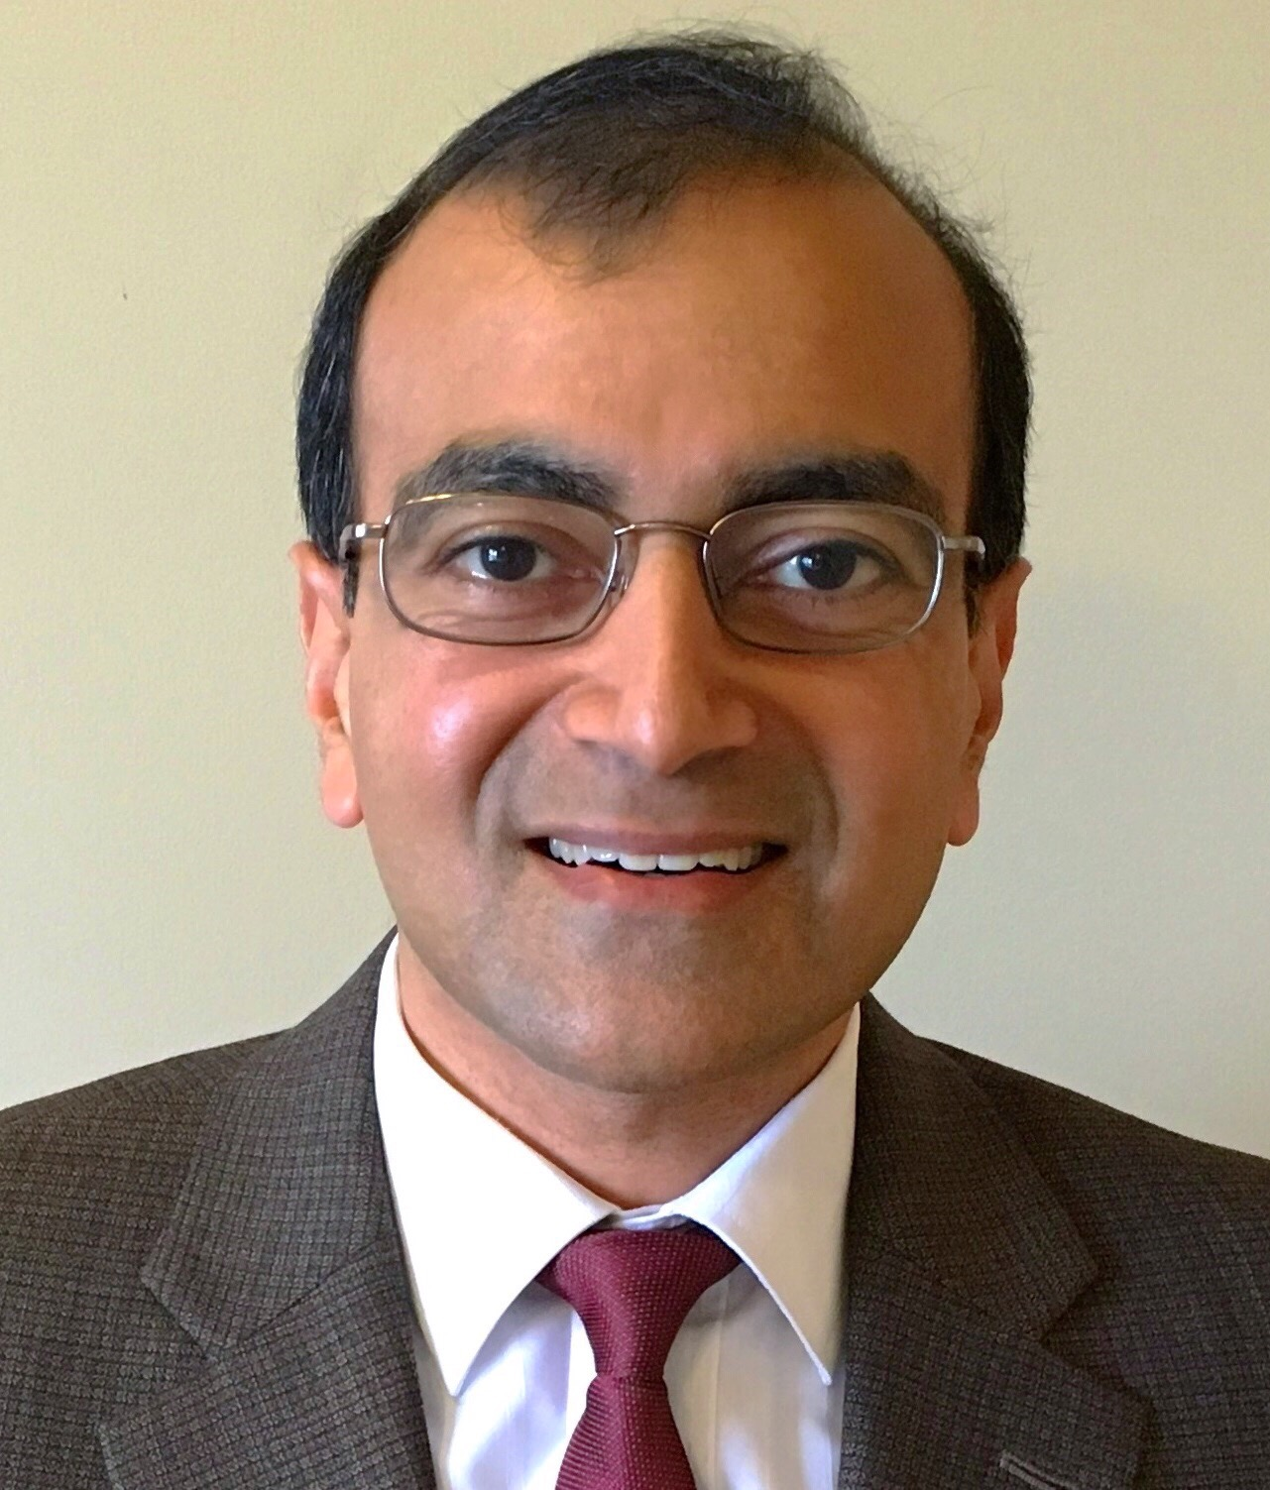
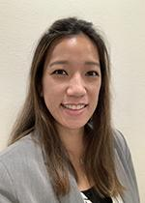
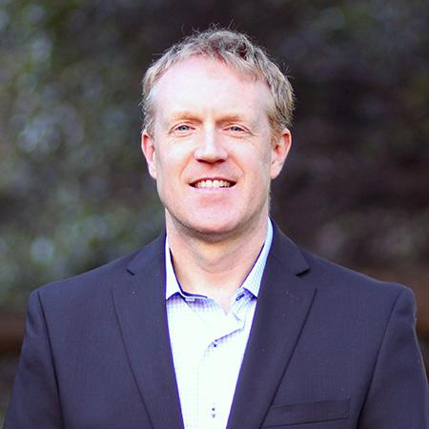
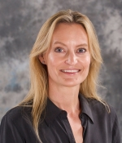
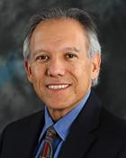
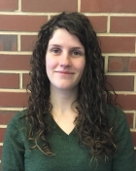

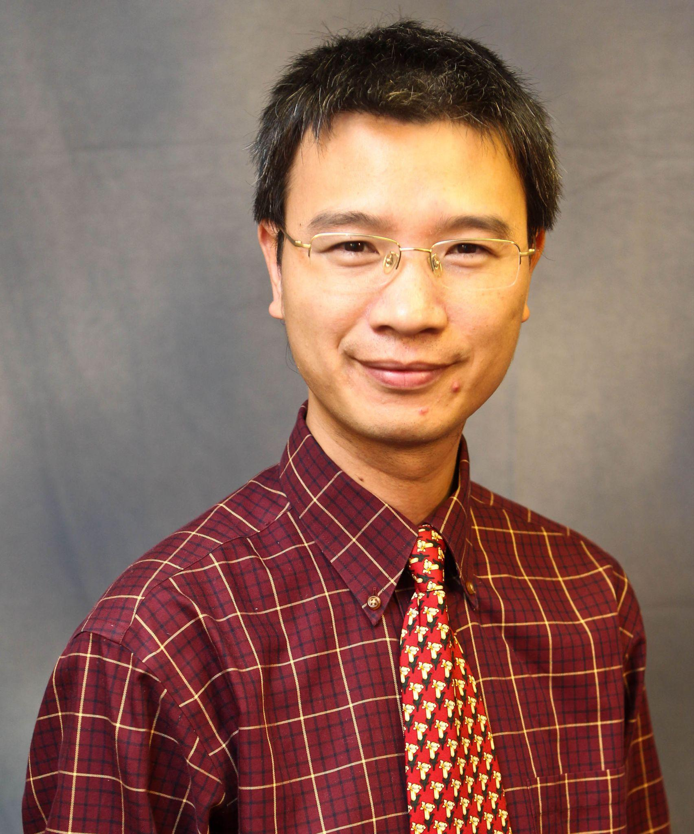
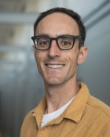
Our Team: Interinstitutional, Intersegmental
Yasmeen Rawajfih
Mandoye Ndoye
Suzanne Sindi
Roummel Marcia
Rosemarie Bongers
Alex Strang
Deborah Nolan
Kyla Oh
Vivian Carter
Johnnie Williams
Mohammed Qazi
Heather Bortfeld
Juan Meza
Erica Rutter
Lisa Yan
David Harding
Nnenna Umollah
Fan Wu
Adrien Peltzer

Slide 11
Our Team: Interdisciplinary
Yasmeen Rawajfih
Johnnie Williams
Suzanne Sindi
Roummel Marcia
Juan Meza
Heather Bortfeld
Deborah Nolan
Vivian Carter
Nnenna Umollah
Alex Strang
Adrien Peltzer
Mohammed Qazi
Fan Wu
Computer Science, Electrical Engineering
Math, Applied Math, Statistics
David Harding
Lisa Yan
Behavioral and Social Sciences
Mandoye Ndoye
Rosemarie Bongers
Erica Rutter
Kyla Oh

Slide 12
Our Team: Curriculum Modules
Kyla Oh
Johnnie Williams
Yasmeen Rawajfih
Deborah Nolan
Lisa Yan
Juan Meza
David Harding
Mandoye Ndoye
Erica Rutter
Heather Bortfeld
Suzanne Sindi
Adrien Peltzer
Roummel Marcia
Vivian Carter
Rosemarie Bongers
Alex Strang
Introduction to Data Fundamentals
Visualization and Tables
Algorithms and Functions
Privacy and Text Data

Slide 13
Our Team: Management
Fan Wu
Mohammed Qazi
Kyla Oh
Johnnie Williams
Yasmeen Rawajfih
Deborah Nolan
Lisa Yan
Juan Meza
David Harding
Mandoye Ndoye
Erica Rutter
Heather Bortfeld
Suzanne Sindi
Adrien Peltzer
Roummel Marcia
Vivian Carter
Rosemarie Bongers
Alex Strang
Introduction to Data Fundamentals
Visualization and Tables
Algorithms and Functions
Privacy and Text Data

Slide 14

Curriculum Development
Online (Zoom):
Curriculum Module Teams (biweekly)
All PI meetings (monthly)
Management meetings (monthly)
In-person:
Kickoff @ National Workshop 2023
DUBOIS/Data 6 Curriculum Workshop @ National Workshop 2024! (yesterday)
Integrate full semester curriculum
Culturally responsive pedagogy w/

Slide 15
AY23-24: Develop Curriculum
Summer 2023
Fall 2023
Spring 2024
Kickoff!
Networking and brainstorm
Project Planning & Organization
Student curriculum developers
IT Staff @ UC Merced
Course approval at all institutions
Course Pilot at Freshman Spark Seminar, UC Merced
notebook infrastructure
instructor professional development

Slide 16

AY23-24: Develop Curriculum → AY24-25: Offer Course
Summer 2023
Fall 2023
Spring 2024
Kickoff!
Networking and brainstorm
Project Planning & Organization
Student curriculum developers
IT Staff @ UC Merced
Course approval at all institutions
Course Pilot at Freshman Spark Seminar, UC Merced
notebook infrastructure
instructor professional development
Summer 2024
Fall 2024
Spring 2025
Offering @ UC Berkeley
First full module integration in new curriculum
3 Offerings @ Laney, UC Berkeley, LACC
2 Offerings @ UC Merced, Tuskegee University
Open-source, modular/unified curriculum!!

Slide 17
I’m interested! How do I get more info?
Project website:
https://dubois-ctds.github.io/
A first draft:
https://data6.org/

Slide 18
I’m interested! How do I get more info?
The full curriculum with all case study modules will be available in 2025. Stay in the loop with more updates by filling out our Google Form!
Project website:
https://dubois-ctds.github.io/
A first draft:
https://data6.org/

Slide 19
Data 6 Panel
Deb Nolan
Johnnie Williams
Yasmeen Rawajfih
Juan Meza

Slide 20
PANELIST PRESENTATIONS BEGIN HERE

Slide 21
Panel order/overview
Deb / UC Berkeley
History of Data 6 at this institution
Johnnie / Laney College
Data 8 → Data 6 evolution, level of preparation of students
HS / 4yr college / articulation + “AI” preparation / concrete next step
Yasmeen / Tuskegee
Tuskegee Scholars experience with Data 6 vs. Data 8
Plans for Data 6 (big), Data 8 (small, flipped) at Tuskegee
UC Merced
Data 6 as a Spark Seminar → as a potentially future class
Spark seminar curricular adaptation examples

Slide 22
Deb Nolan,
UC Berkeley

Slide 23
CHALLENGE: Data 8 for students with no programming background, often social science students
Alternative: Summer preparatory computing course
Computing
Statistics
DATA 8
Alternative: Add social science + satisfy breadth requirement
DATA 6
CHALLENGE: satisfy the SocSci breadth requirement
DUBOIS collaboration
Offer in regular academic year
Context

Slide 24
Johnnie Williams, Laney College
Computer Information Systems Department (CIS)
Department Co-Chair

Slide 25
Laney CIS Department Guiding Principles for Course / Program Development:
Meeting students where they are developmentally.
Duplicating successful course structures
Certificate of Achievement and Associate Degree creation with minimal new course creation
Collaborating, Compromising, and “Sharing students” with other departments. (Math)

Slide 26
Why Data 6 for Laney College? (CIS 116 & MATH 116, Approved Spring Semester 2024)
Data 6 aligns with Laney CIS and Math department Data Science course and certificate goals.
Data Science Fundamentals Certificate of Achievement
(17 Units, CIS 116, Math 118, Intro to Excel, Intro to SQL)
Data Science AS in Data Analytics and AS in Data Science
Programming Emphasis / Job Placement vs Math Calculus Series for Transfer
Data 6 aligns well with courses currently offered in the Laney CIS Department.
Data 6 currently fulfills / aligns with 1st level programming courses offered at Laney with high student enrollment. (Introduction to Programming, Intro to Object Oriented Programming [C++, Java])
Data 6 was articulated to CSU System Spring 2024 and UCB by Fall 2024(hopefully).
Data 6 student learning objects align with in demand skills for Internships and Entry Level Jobs.
(Career Technical Education [CTE])

Slide 27

Yasmeen Rawajfih, Tuskegee University
Department of Computer Science

Slide 28
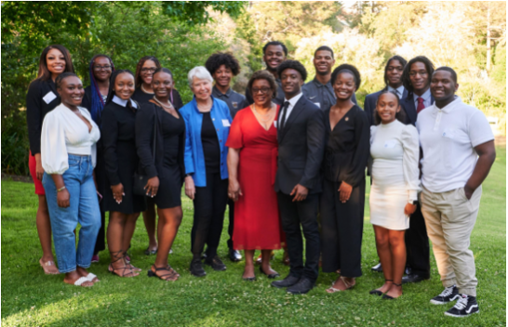
Tuskegee Scholars at UC Berkeley (AY22-23)
Summer 2022
Fall 2022
First cohort - 13 scholars
Data 6 or Data 8 depending on major and comfort level
Research showcase
First offering of Data 8 at Tuskegee
No prerequisites
Some students that took Data 6 enrolled in Data 8
2 summer scholars hired as TAs for the course

Slide 29
Tuskegee Scholars at UC Berkeley (AY23-24 & AY24-25)
Data 6 and Data 8 at Tuskegee (AY24-25)
Summer 2023
Fall 2023
Summer 2024
Fall 2024
Spring 2025
Second cohort - 13 scholars
Data 8
Second cohort - 12 scholars
Data 8
First offering of Data 6
Data 6
•Available to all majors & classifications
•No prerequisites
•Engaging first experience in data science
•Larger class expected (25 – 30)
•Traditional delivery method
Data 8
•Available as a CS elective to CS majors
•Some programming experience expected
•Smaller classes (~ 10)
•Flipped classroom

Slide 30
Juan Meza, UC Merced
Applied Mathematics Department

Slide 31
Spark 010 - Thinking with Data
Materials based on Data 6 @ UC Berkeley (materials-su23 )
2 unit course designed for students without previous programming experience
Used JupyterHub as main platform with notebooks hosted in shared folder (github)
Datasets used:
Kaggle’s Fast Food Restaurants
U.S. State Populations
Housing Prices Data (Zillow)
Number of Internet users (ourworldindata.org)
UC Merced Enrollment (Private)

Slide 32
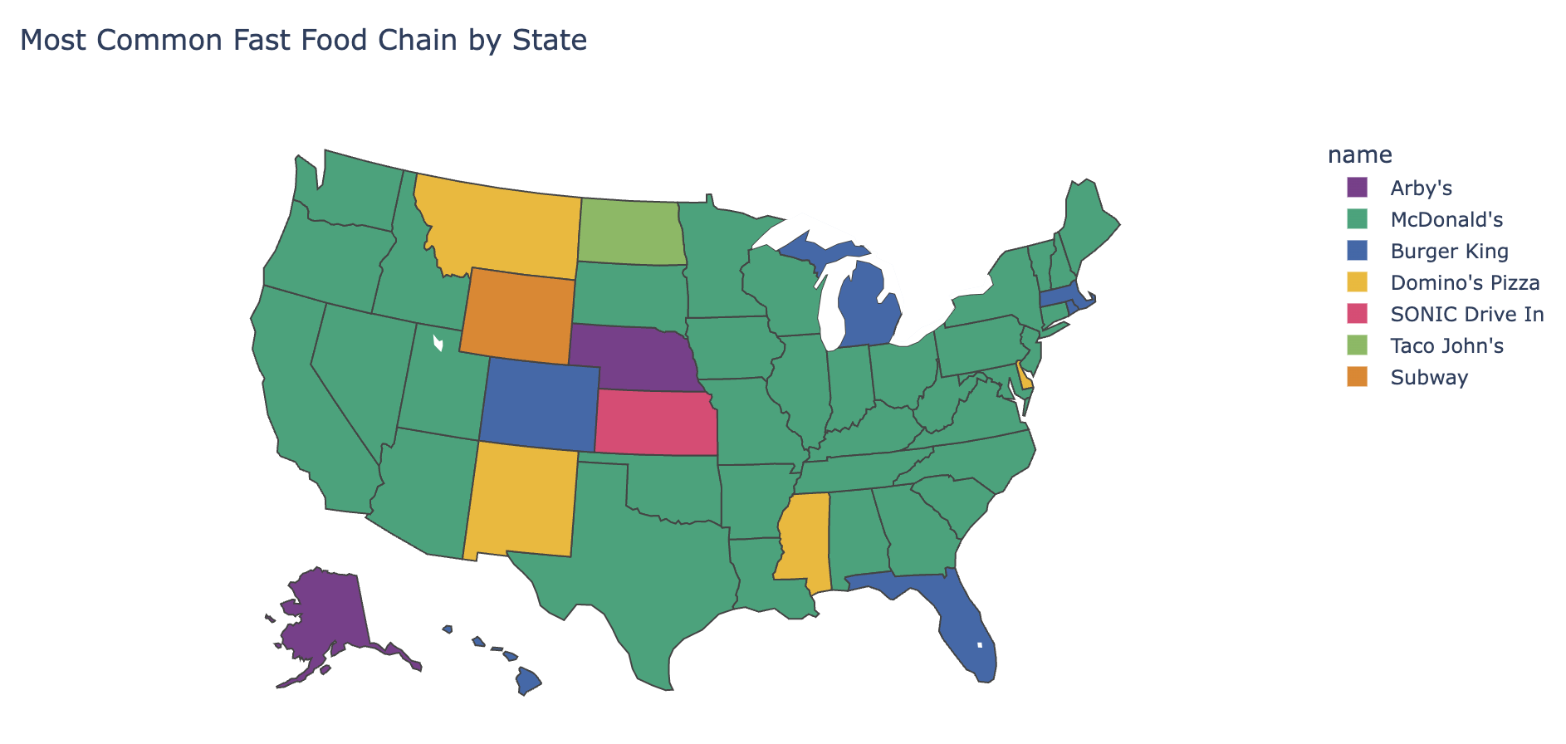
Learning Outcomes
Python Fundamentals
data structures
variables
Summary statistics
Skills and confidence in conducting analysis on “real-world” data
Graphing Data
Visualizations
Fun Example: Chloropleth Maps
Goals: Teach how to solve problems and develop skills for computational thinking

Slide 33
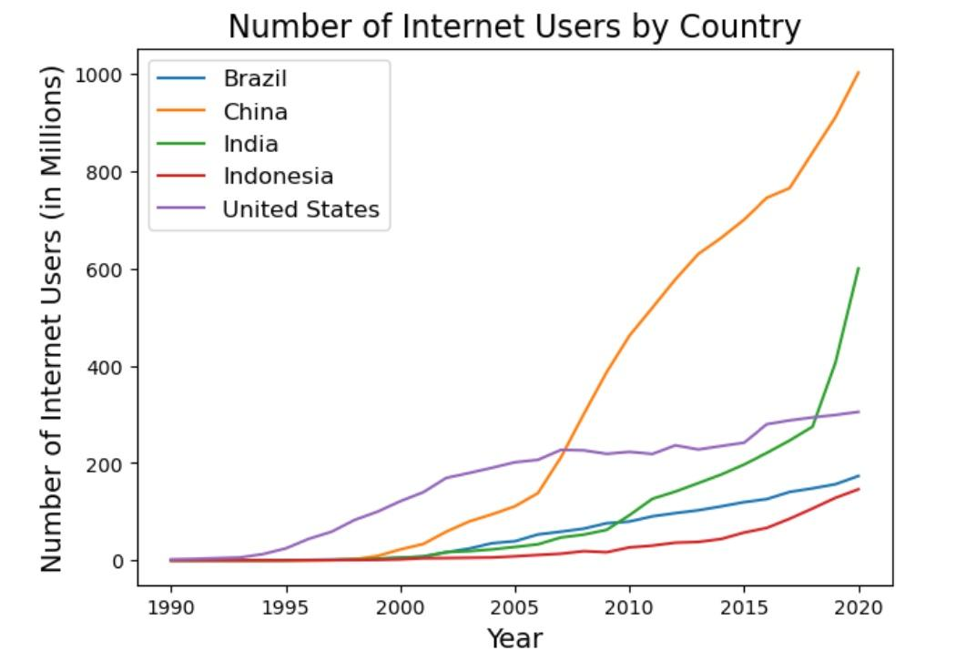
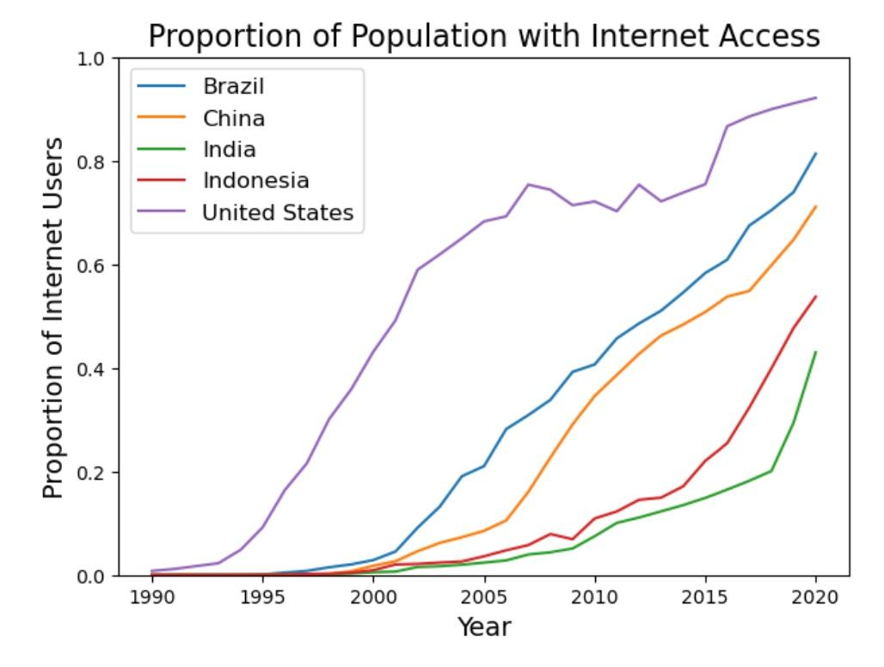
Learning Outcomes
Python Fundamentals
data structures
Variables
etc.
Summary Statistics
Skills and confidence in conducting analysis on “real-world” data
Graphing Data
Visualizations
Example: Internet Users by Country

Slide 34
Lessons Learned
Use more frequent checkpoints / review previously covered material
Teach to all levels of background “CS” knowledge
Hands-on learning, help students in 1-to-1 setting
Did not cover all material from Data 6 (only 16 out of 26 lectures)

Slide 35
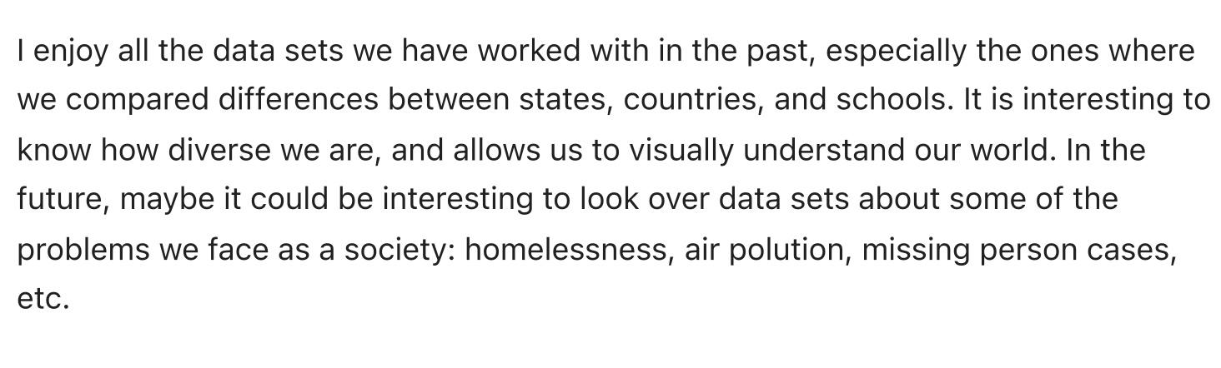
Next Steps
Case Studies
Develop and incorporate more examples/datasets from Social Science settings
Convert course from two to three units
Additional Projects
Additional material

Slide 36
Panel Q&A
Project website:
https://dubois-ctds.github.io/
A first draft:
https://data6.org/
Interest Form:
Deb Nolan
Johnnie Williams
Yasmeen Rawajfih
Juan Meza

